Slide 1
Word 2007: Mail Merge

Slide 2
What is Mail Merge?
Mail merge is a method of taking data from a database or spreadsheet and inserting it into documents such as letters, mailing labels, and name tags.
A mail merge requires two files:
One contains the information that will be the same for each document.
The other stores the variable data you want to insert.

Slide 3
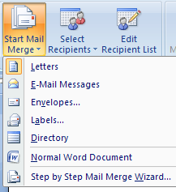
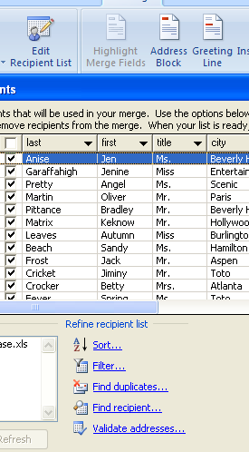
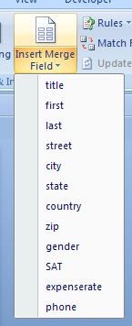
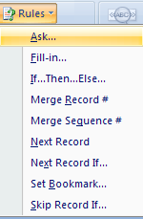
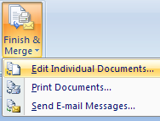
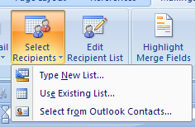
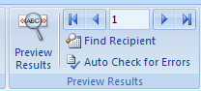
Mail Merge Ribbon
Start the Mail Merge Wizard.
Refine Recipient list by using the options in this window.
Column headers from your data source will appear as merge field choices.
Use Rules for additional customization and validation.
“Edit Individual Documents” to proof and/or save the completed merge as a new document.
Use Existing List is the most common choice.
Preview and scroll through results before merging.

Slide 4
Mail Merge Steps
Set up the main document. The main document contains the text and graphics that are the same for each version of the merged document, for example, the return address or salutation in a form letter.
Connect the document to a data source. A data source is a file that contains the information to be merged into a document, for example, the names and addresses of the recipients of a letter.
Refine the list of recipients or items. If you want to generate copies for only certain items in your data file, you can choose which items (records) to include.
Add placeholders (mail merge fields) to the document. When you perform the mail merge, the mail merge fields are filled with information from your data file.
Preview and complete the merge. You can preview each page of the document before you print the whole set.

Slide 5
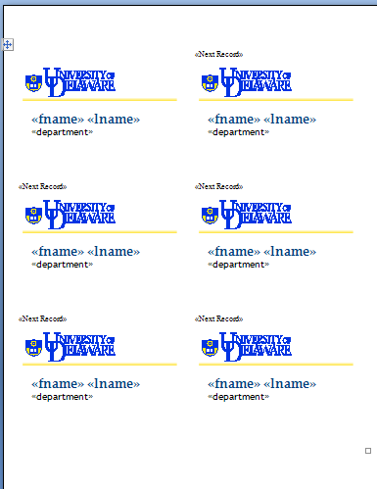
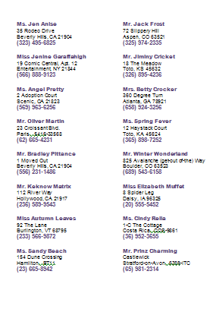
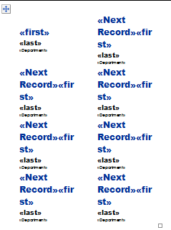
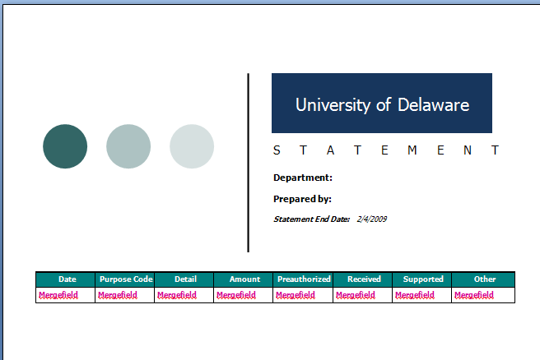
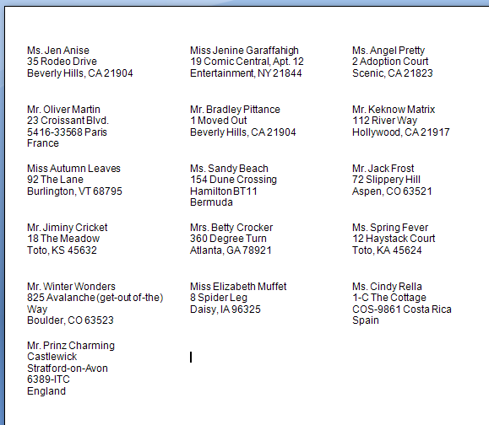
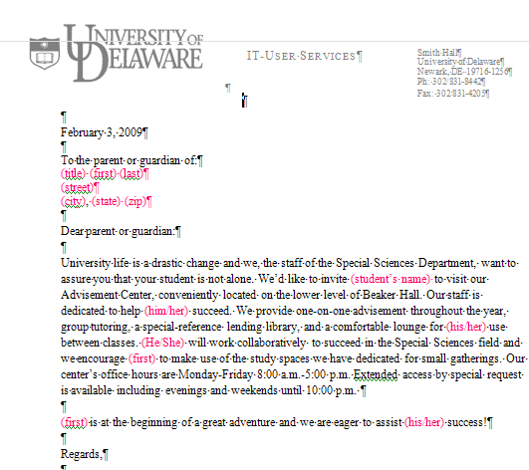
Merge Samples
sample

Slide 6
Retaining Number Formats
Preformatted numbers from Excel worksheets—percentages, currency, phone numbers, dates, or postal codes—will not display properly in your merge unless you complete the following steps:
Change the default settings in Word:
Microsoft Office Button ⇒ Word Options
Advanced ⇒ General
Confirm file format conversion on open check box
OK
During the mail merge process, click Select Recipients ⇒ Use Existing List.
Locate the Excel worksheet in the Select Data Source dialog box, and double-click it.
In the Confirm Data Source dialog box, click MS Excel Worksheets via DDE (*.xls) then click OK.
Note: If you don't see MS Excel Worksheets via DDE (*.xls), select the Show all check box

Slide 7
Resources
University of Delaware Resources
www.udel.edu/learn, learnit-info@udel.edu
www.udel.edu/help, consult@udel.edu, 831-6000
www.udel.edu/cod/minoffice/index.html
Help within Microsoft Word, keyword: mail merge
Look for: “Use mail merge to create and print letters and other documents”
Microsoft Tutorials (http://office.microsoft.com/training/)
Mail merge I: Use mail merge for mass mailings
Mail merge II: Use the Ribbon and perform a complex mail merge

